Slide 1
Analysis of CLOCKED SEQENTIAL CIRCUITS
Lecture No 5

Slide 2
ANALYSIS OF CLOCKED SEQENTIAL CIRCUITS
ANALYSIS describes what circuit will do under certain operation conditions
CLOCKED SEQENTIAL CIRCUIT is one with FLIP FLOPS with a clocked input
STEPS OF ANALYSIS
Circuit Diagram
State Equations
State Table
State Diagram

Slide 3
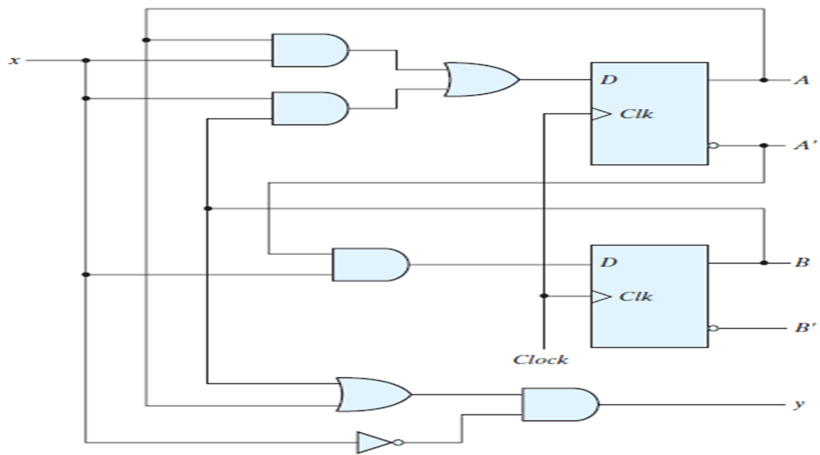
CIRCUIT DIAGRAM

Slide 4
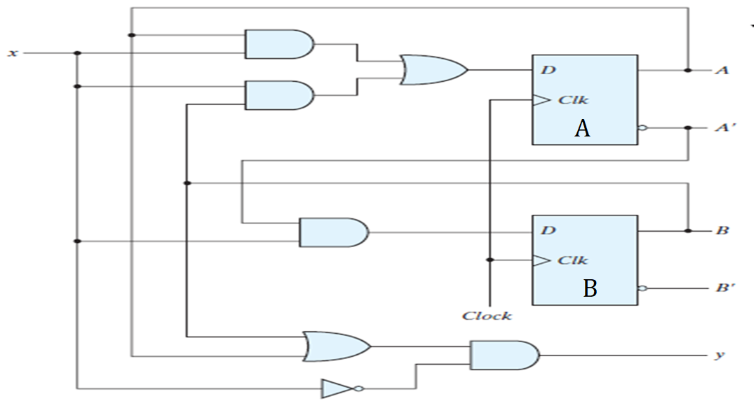
CIRCUIT DIAGRAM

Slide 5
STATE EQUATIONS
TRANSITION EQUATIONS
Describes behavior of CLOCKED SEQUENTIAL CIRCUITS

Slide 6
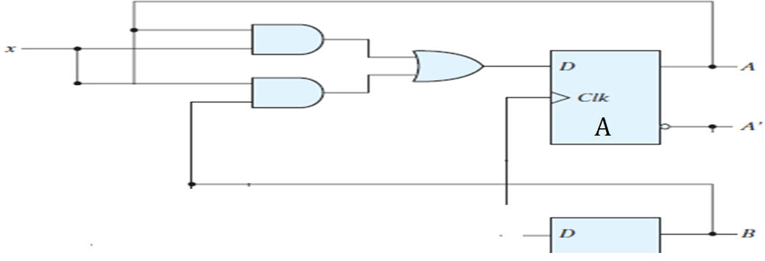
STATE EQUATIONS FOR FLIP FLOP A

Slide 7
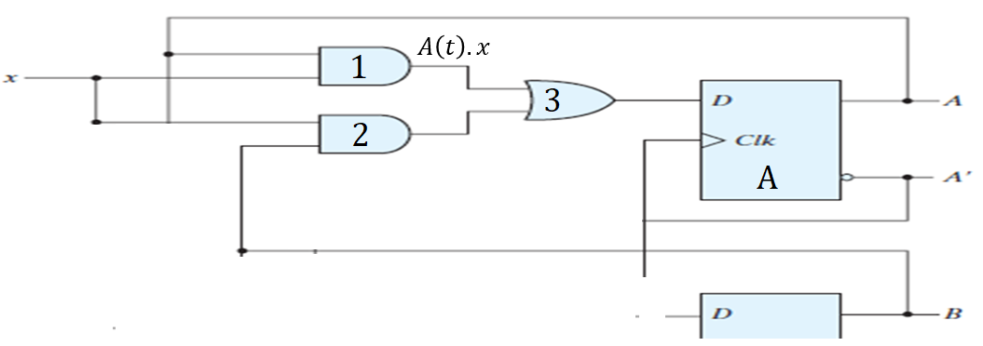

STATE EQUATIONS FOR FLIP FLOP A
$$A\left(t+1\right)=A\left(t\right).x$$

Slide 8
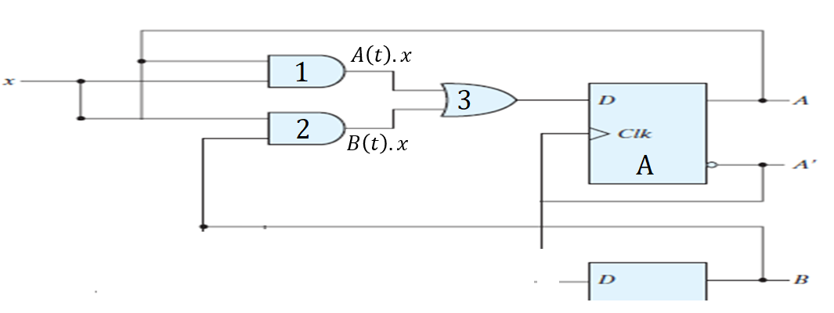

STATE EQUATIONS FOR FLIP FLOP A
$$A\left(t+1\right)=A\left(t\right).x(t)+B\left(t\right).x(t)$$

Slide 9

STATE EQUATIONS FOR FLIP FLOP A
$$A\left(t+1\right)=A\left(t\right).x(t)+B\left(t\right).x(t)$$
$$A\left(t+1\right)=A.x+B.x$$

Slide 10
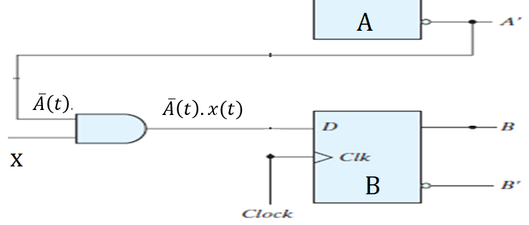

STATE EQUATIONS FOR FLIP FLOP B
$$B(t+1)=\overline{A}\left(t\right).x(t)$$
$$B(t+1)=\overline{A}.x$$

Slide 11
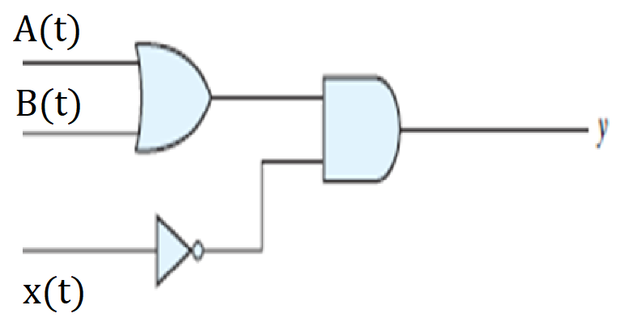

STATE EQUATIONS FOR OUTPUT y
$$y\left(t\right)=[A\left(t\right)+B(t)].\overline{x}(t)$$
$$y=\left(A+B\right).\overline{x }$$

Slide 12
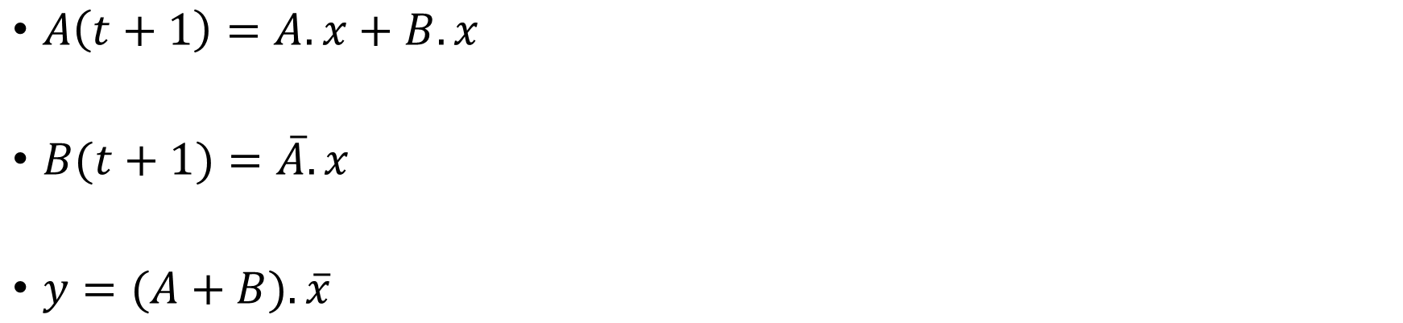
STATE EQUATIONS
$A\left(t+1\right)=A.x+B.x$
$B(t+1)=\overline{A}.x$
$y=(A+B).\overline{x}$

Slide 13
STATE TABLE
TRANSITION TABLE
Consist of four Sections
PRESENT STATE
INPUT
NEXT STATE
OUTPUT

Slide 14
STATE TABLE: PRESENT STATE
State of flip flop A and B at any given time t
PRESENT STATE
A | B
0 | 0
0 | 1
1 | 0
1 | 1

Slide 15
STATE TABLE: PRESENT STATE & INPUT
State of flip flop A and B at any given time t
Input gives value of x for each possible present state
PRESENT STATE |  | INPUT
A | B | X
0 | 0 | 0
0 | 0 | 1
0 | 1 | 0
0 | 1 | 1
1 | 0 | 0
1 | 0 | 1
1 | 1 | 0
1 | 1 | 1

Slide 16




STATE TABLE: PRESENT STATE,INPUT & NEXT STATE
Next state for A(t+1)
PRESENT STATE |  | INPUT | NEXT STATE
A | B | X | A(t+1)
0 | 0 | 0 | 0
0 | 0 | 1
0 | 1 | 0
0 | 1 | 1
1 | 0 | 0
1 | 0 | 1
1 | 1 | 0
1 | 1 | 1
$$A\left(t+1\right)=A.x+B.x$$
Where A=0, B=0, x=0
$$A\left(t+1\right)=0.0+0.0$$
$$A\left(t+1\right)=0+0$$
$$A\left(t+1\right)=0$$

Slide 17

STATE TABLE: PRESENT STATE,INPUT & NEXT STATE
Next state for A(t+1)
PRESENT STATE |  | INPUT | NEXT STATE
A | B | X | A(t+1)
0 | 0 | 0 | 0
0 | 0 | 1 | 0
0 | 1 | 0
0 | 1 | 1
1 | 0 | 0
1 | 0 | 1
1 | 1 | 0
1 | 1 | 1
$$A\left(t+1\right)=A.x+B.x$$
Where A=0, B=0, x=1
$$A\left(t+1\right)=0.1+0.1$$
$$A\left(t+1\right)=0+0$$
$$A\left(t+1\right)=0$$

Slide 18

STATE TABLE: PRESENT STATE,INPUT & NEXT STATE
Next state for A(t+1)
PRESENT STATE |  | INPUT | OUTPUT
A | B | X | A(t+1)
0 | 0 | 0 | 0
0 | 0 | 1 | 0
0 | 1 | 0 | 0
0 | 1 | 1
1 | 0 | 0
1 | 0 | 1
1 | 1 | 0
1 | 1 | 1
$$A\left(t+1\right)=A.x+B.x$$
Where A=0, B=1, x=0
$$A\left(t+1\right)=0.0+1.0$$
$$A\left(t+1\right)=0+0$$
$$A\left(t+1\right)=0$$

Slide 19



STATE TABLE: PRESENT STATE,INPUT & NEXT STATE
Next state for A(t+1)
PRESENT STATE |  | INPUT | NEXT STATE
A | B | X | A(t+1)
0 | 0 | 0 | 0
0 | 0 | 1 | 0
0 | 1 | 0 | 0
0 | 1 | 1 | 1
1 | 0 | 0
1 | 0 | 1
1 | 1 | 0
1 | 1 | 1
$$A\left(t+1\right)=A.x+B.x$$
Where A=0, B=1, x=1
$$A\left(t+1\right)=0.1+1.1$$
$$A\left(t+1\right)=0+1$$
$$A\left(t+1\right)=1$$

Slide 20
STATE TABLE: PRESENT STATE,INPUT & NEXT STATE
Next state for A(t+1)
PRESENT STATE |  | INPUT | NEXT STATE
A | B | X | A
0 | 0 | 0 | 0
0 | 0 | 1 | 0
0 | 1 | 0 | 0
0 | 1 | 1 | 1
1 | 0 | 0 | 0
1 | 0 | 1 | 1
1 | 1 | 0 | 0
1 | 1 | 1 | 1

Slide 21





STATE TABLE: PRESENT STATE,INPUT & NEXT STATE
Next state for B(t+1)
PRESENT STATE |  | INPUT | NEXT STATE
A | B | X | A | B(t+1)
0 | 0 | 0 | 0 | 0
0 | 0 | 1 | 0
0 | 1 | 0 | 0 | 0
0 | 1 | 1 | 1
1 | 0 | 0 | 0
1 | 0 | 1 | 0
1 | 1 | 0 | 0
1 | 1 | 1 | 1
$$B(t+1)=\overline{A}.x$$
$$Where A=0, x=0$$
$$B(t+1)=\overline{0}.0$$
$$B(t+1)=1.\text{0 }$$
$$B(t+1)=0$$

Slide 22




STATE TABLE: PRESENT STATE,INPUT & NEXT STATE
Next state for B(t+1)
PRESENT STATE |  | INPUT | NEXT STATE
A | B | X | A | B(t+1)
0 | 0 | 0 | 0 | 0
0 | 0 | 1 | 0 | 1
0 | 1 | 0 | 0 | 0
0 | 1 | 1 | 1 | 1
1 | 0 | 0 | 0
1 | 0 | 1 | 0
1 | 1 | 0 | 0
1 | 1 | 1 | 1
$$B(t+1)=\overline{A}.x$$
$$Where A=0, x=1$$
$$B(t+1)=\overline{0}.1$$
$$B(t+1)=1.\text{1 }$$
$$B(t+1)=1$$

Slide 23
STATE TABLE: PRESENT STATE,INPUT & NEXT STATE
Next state for B(t+1)
PRESENT STATE |  | INPUT | NEXT STATE
A | B | X | A | B
0 | 0 | 0 | 0 | 0
0 | 0 | 1 | 0 | 1
0 | 1 | 0 | 0 | 0
0 | 1 | 1 | 1 | 1
1 | 0 | 0 | 0 | 0
1 | 0 | 1 | 0 | 0
1 | 1 | 0 | 0 | 0
1 | 1 | 1 | 1 | 0

Slide 24





STATE TABLE: PRESENT STATE, INPUT, NEXT STATE & OUTPUT
OUTPUT
PRESENT STATE |  | INPUT | NEXT STATE |  | OUTPUT
A | B | X | A | B | y
0 | 0 | 0 | 0 | 0 | 0
0 | 0 | 1 | 0 | 1
0 | 1 | 0 | 0 | 0
0 | 1 | 1 | 1 | 1
1 | 0 | 0 | 0 | 0
1 | 0 | 1 | 0 | 0
1 | 1 | 0 | 0 | 0
1 | 1 | 1 | 1 | 0
$$y=(A+B).\overline{x}$$
$$Where A=0,B=0, x=0$$
$$y=(0+0).\overline{0}$$
$$y=(0).1$$
$$y=0$$

Slide 25



STATE TABLE: PRESENT STATE, INPUT, NEXT STATE & OUTPUT
OUTPUT
PRESENT STATE |  | INPUT | NEXT STATE |  | OUTPUT
A | B | X | A | B | y
0 | 0 | 0 | 0 | 0 | 0
0 | 0 | 1 | 0 | 1 | 0
0 | 1 | 0 | 0 | 0
0 | 1 | 1 | 1 | 1
1 | 0 | 0 | 0 | 0
1 | 0 | 1 | 0 | 0
1 | 1 | 0 | 0 | 0
1 | 1 | 1 | 1 | 0
$$y=(A+B).\overline{x}$$
$$Where A=0,B=0, x=1$$
$$y=(0+0).\overline{1}$$
$$y=(0).0$$
$$y=0$$

Slide 26




STATE TABLE: PRESENT STATE, INPUT, NEXT STATE & OUTPUT
OUTPUT
PRESENT STATE |  | INPUT | NEXT STATE |  | OUTPUT
A | B | X | A | B | y
0 | 0 | 0 | 0 | 0 | 0
0 | 0 | 1 | 0 | 1 | 0
0 | 1 | 0 | 0 | 0 | 1
0 | 1 | 1 | 1 | 1
1 | 0 | 0 | 0 | 0
1 | 0 | 1 | 0 | 0
1 | 1 | 0 | 0 | 0
1 | 1 | 1 | 1 | 0
$$y=(A+B).\overline{x}$$
$$Where A=0,B=1, x=0$$
$$y=(0+1).\overline{0}$$
$$y=(1).1$$
$$y=1$$

Slide 27



STATE TABLE: PRESENT STATE, INPUT, NEXT STATE & OUTPUT
OUTPUT
PRESENT STATE |  | INPUT | NEXT STATE |  | OUTPUT
A | B | X | A | B | y
0 | 0 | 0 | 0 | 0 | 0
0 | 0 | 1 | 0 | 1 | 0
0 | 1 | 0 | 0 | 0 | 1
0 | 1 | 1 | 1 | 1 | 0
1 | 0 | 0 | 0 | 0
1 | 0 | 1 | 0 | 0
1 | 1 | 0 | 0 | 0
1 | 1 | 1 | 1 | 0
$$y=(A+B).\overline{x}$$
$$Where A=0,B=1, x=1$$
$$y=(0+1).\overline{1}$$
$$y=(1).0$$
$$y=0$$

Slide 28


STATE TABLE: PRESENT STATE, INPUT, NEXT STATE & OUTPUT
OUTPUT
PRESENT STATE |  | INPUT | NEXT STATE |  | OUTPUT
A | B | X | A | B | y
0 | 0 | 0 | 0 | 0 | 0
0 | 0 | 1 | 0 | 1 | 0
0 | 1 | 0 | 0 | 0 | 1
0 | 1 | 1 | 1 | 1 | 0
1 | 0 | 0 | 0 | 0 | 1
1 | 0 | 1 | 0 | 0 | 0
1 | 1 | 0 | 0 | 0 | 1
1 | 1 | 1 | 1 | 0 | 0
$$y=(A+B).\overline{x}$$
$$Where A=1,B=0, x=0$$
$$y=(1+0).\overline{0}$$
$$y=(1).1$$
$$y=1$$

Slide 29
STATE TABLE: PRESENT STATE, INPUT, NEXT STATE & OUTPUT
PRESENT STATE |  | NEXT STATE |  |  |  | OUTPUT
 |  | x=0 |  | x=1 |  | x=0 | x=1
A | B | A | B | A | B | y | y
0 | 0
0 | 1
1 | 0
1 | 1
PRESENT STATE |  | INPUT | NEXT STATE |  | OUTPUT
A | B | X | A | B | y
0 | 0 | 0 | 0 | 0 | 0
0 | 0 | 1 | 0 | 1 | 0
0 | 1 | 0 | 0 | 0 | 1
0 | 1 | 1 | 1 | 1 | 0
1 | 0 | 0 | 0 | 0 | 1
1 | 0 | 1 | 0 | 0 | 0
1 | 1 | 0 | 0 | 0 | 1
1 | 1 | 1 | 1 | 0 | 0

Slide 30
STATE TABLE: PRESENT STATE, INPUT, NEXT STATE & OUTPUT
PRESENT STATE |  | NEXT STATE |  |  |  | OUTPUT
 |  | x=0 |  | x=1 |  | x=0 | x=1
A | B | A | B | A | B | y | y
0 | 0 | 0 | 0 |  |  | 0
0 | 1
1 | 0
1 | 1
PRESENT STATE |  | INPUT | NEXT STATE |  | OUTPUT
A | B | X | A | B | y
0 | 0 | 0 | 0 | 0 | 0
0 | 0 | 1 | 0 | 1 | 0
0 | 1 | 0 | 0 | 0 | 1
0 | 1 | 1 | 1 | 1 | 0
1 | 0 | 0 | 0 | 0 | 1
1 | 0 | 1 | 0 | 0 | 0
1 | 1 | 0 | 0 | 0 | 1
1 | 1 | 1 | 1 | 0 | 0

Slide 31
STATE TABLE: PRESENT STATE, INPUT, NEXT STATE & OUTPUT
PRESENT STATE |  | NEXT STATE |  |  |  | OUTPUT
 |  | x=0 |  | x=1 |  | x=0 | x=1
A | B | A | B | A | B | y | y
0 | 0 | 0 | 0 | 0 | 1 | 0 | 0
0 | 1
1 | 0
1 | 1
PRESENT STATE |  | INPUT | NEXT STATE |  | OUTPUT
A | B | X | A | B | y
0 | 0 | 0 | 0 | 0 | 0
0 | 0 | 1 | 0 | 1 | 0
0 | 1 | 0 | 0 | 0 | 1
0 | 1 | 1 | 1 | 1 | 0
1 | 0 | 0 | 0 | 0 | 1
1 | 0 | 1 | 0 | 0 | 0
1 | 1 | 0 | 0 | 0 | 1
1 | 1 | 1 | 1 | 0 | 0

Slide 32
STATE TABLE: PRESENT STATE, INPUT, NEXT STATE & OUTPUT
PRESENT STATE |  | NEXT STATE |  |  |  | OUTPUT
 |  | x=0 |  | x=1 |  | x=0 | x=1
A | B | A | B | A | B | y | y
0 | 0 | 0 | 0 | 0 | 1 | 0 | 0
0 | 1 | 0 | 0 |  |  | 1
1 | 0
1 | 1
PRESENT STATE |  | INPUT | NEXT STATE |  | OUTPUT
A | B | X | A | B | y
0 | 0 | 0 | 0 | 0 | 0
0 | 0 | 1 | 0 | 1 | 0
0 | 1 | 0 | 0 | 0 | 1
0 | 1 | 1 | 1 | 1 | 0
1 | 0 | 0 | 0 | 0 | 1
1 | 0 | 1 | 0 | 0 | 0
1 | 1 | 0 | 0 | 0 | 1
1 | 1 | 1 | 1 | 0 | 0

Slide 33
STATE TABLE: PRESENT STATE, INPUT, NEXT STATE & OUTPUT
PRESENT STATE |  | NEXT STATE |  |  |  | OUTPUT
 |  | x=0 |  | x=1 |  | x=0 | x=1
A | B | A | B | A | B | y | y
0 | 0 | 0 | 0 | 0 | 1 | 0 | 0
0 | 1 | 0 | 0 | 1 | 1 | 1 | 0
1 | 0
1 | 1
PRESENT STATE |  | INPUT | NEXT STATE |  | OUTPUT
A | B | X | A | B | y
0 | 0 | 0 | 0 | 0 | 0
0 | 0 | 1 | 0 | 1 | 0
0 | 1 | 0 | 0 | 0 | 1
0 | 1 | 1 | 1 | 1 | 0
1 | 0 | 0 | 0 | 0 | 1
1 | 0 | 1 | 0 | 0 | 0
1 | 1 | 0 | 0 | 0 | 1
1 | 1 | 1 | 1 | 0 | 0

Slide 34
STATE TABLE: PRESENT STATE, INPUT, NEXT STATE & OUTPUT
PRESENT STATE |  | NEXT STATE |  |  |  | OUTPUT
 |  | x=0 |  | x=1 |  | x=0 | x=1
A | B | A | B | A | B | y | y
0 | 0 | 0 | 0 | 0 | 1 | 0 | 0
0 | 1 | 0 | 0 | 1 | 1 | 1 | 0
1 | 0 | 0 | 0 | 1 | 0 | 1 | 0
1 | 1 | 0 | 0 | 1 | 0 | 1 | 0
PRESENT STATE |  | INPUT | NEXT STATE |  | OUTPUT
A | B | X | A | B | y
0 | 0 | 0 | 0 | 0 | 0
0 | 0 | 1 | 0 | 1 | 0
0 | 1 | 0 | 0 | 0 | 1
0 | 1 | 1 | 1 | 1 | 0
1 | 0 | 0 | 0 | 0 | 1
1 | 0 | 1 | 0 | 0 | 0
1 | 1 | 0 | 0 | 0 | 1
1 | 1 | 1 | 1 | 0 | 0

Slide 35
STATE TABLE:
PRESENT STATE |  | NEXT STATE |  |  |  | OUTPUT
 |  | x=0 |  | x=1 |  | x=0 | x=1
A | B | A | B | A | B | y | y
0 | 0 | 0 | 0 | 0 | 1 | 0 | 0
0 | 1 | 0 | 0 | 1 | 1 | 1 | 0
1 | 0 | 0 | 0 | 1 | 0 | 1 | 0
1 | 1 | 0 | 0 | 1 | 0 | 1 | 0

Slide 36
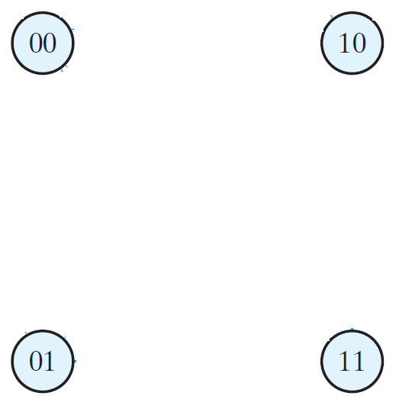
STATE DIAGRAM:
PRESENT STATE |  | NEXT STATE |  |  |  | OUTPUT
 |  | x=0 |  | x=1 |  | x=0 | x=1
A | B | A | B | A | B | y | y
0 | 0 | 0 | 0 | 0 | 1 | 0 | 0
0 | 1 | 0 | 0 | 1 | 1 | 1 | 0
1 | 0 | 0 | 0 | 1 | 0 | 1 | 0
1 | 1 | 0 | 0 | 1 | 0 | 1 | 0

Slide 37
STATE DIAGRAM:
PRESENT STATE |  | NEXT STATE |  |  |  | OUTPUT
 |  | x=0 |  | x=1 |  | x=0 | x=1
A | B | A | B | A | B | y | y
0 | 0 | 0 | 0 | 0 | 1 | 0 | 0
0 | 1 | 0 | 0 | 1 | 1 | 1 | 0
1 | 0 | 0 | 0 | 1 | 0 | 1 | 0
1 | 1 | 0 | 0 | 1 | 0 | 1 | 0

Slide 38
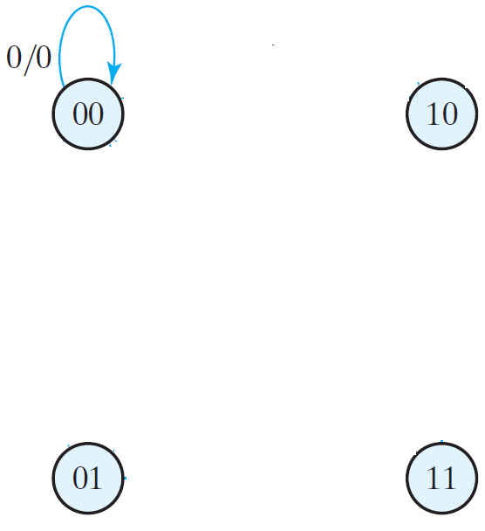
STATE DIAGRAM:
PRESENT STATE |  | NEXT STATE |  |  |  | OUTPUT
 |  | x=0 |  | x=1 |  | x=0 | x=1
A | B | A | B | A | B | y | y
0 | 0 | 0 | 0 | 0 | 1 | 0 | 0
0 | 1 | 0 | 0 | 1 | 1 | 1 | 0
1 | 0 | 0 | 0 | 1 | 0 | 1 | 0
1 | 1 | 0 | 0 | 1 | 0 | 1 | 0
INPUT/OUTPUT

Slide 39
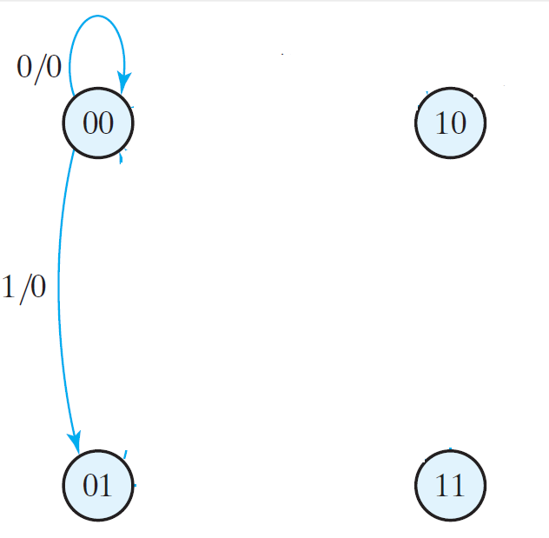
STATE DIAGRAM:
PRESENT STATE |  | NEXT STATE |  |  |  | OUTPUT
 |  | x=0 |  | x=1 |  | x=0 | x=1
A | B | A | B | A | B | y | y
0 | 0 | 0 | 0 | 0 | 1 | 0 | 0
0 | 1 | 0 | 0 | 1 | 1 | 1 | 0
1 | 0 | 0 | 0 | 1 | 0 | 1 | 0
1 | 1 | 0 | 0 | 1 | 0 | 1 | 0

Slide 40
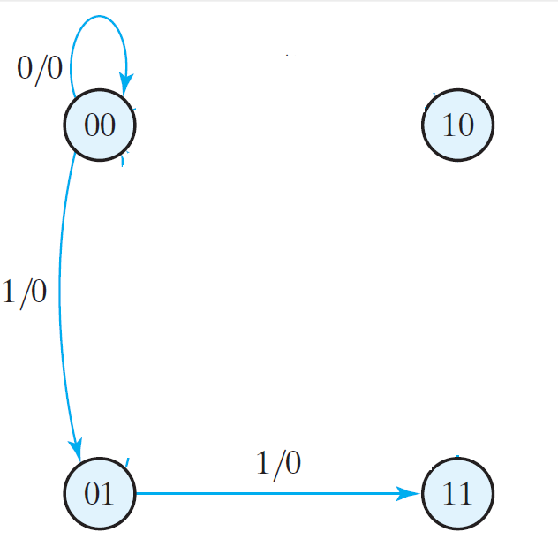
STATE DIAGRAM:
PRESENT STATE |  | NEXT STATE |  |  |  | OUTPUT
 |  | x=0 |  | x=1 |  | x=0 | x=1
A | B | A | B | A | B | y | y
0 | 0 | 0 | 0 | 0 | 1 | 0 | 0
0 | 1 | 0 | 0 | 1 | 1 | 1 | 0
1 | 0 | 0 | 0 | 1 | 0 | 1 | 0
1 | 1 | 0 | 0 | 1 | 0 | 1 | 0

Slide 41
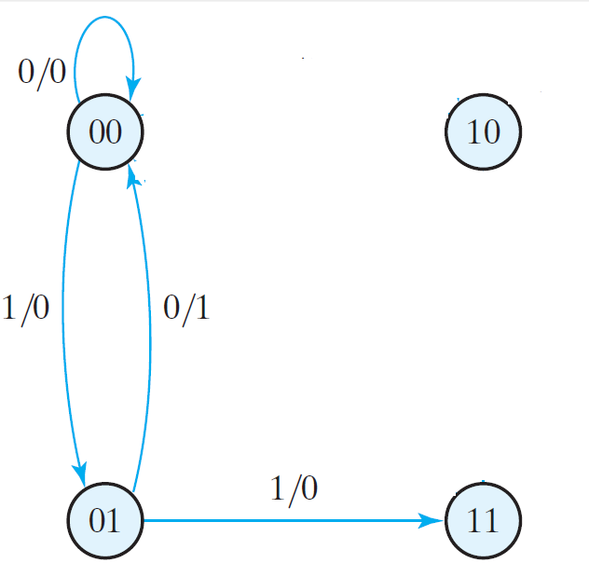
STATE DIAGRAM:
PRESENT STATE |  | NEXT STATE |  |  |  | OUTPUT
 |  | x=0 |  | x=1 |  | x=0 | x=1
A | B | A | B | A | B | y | y
0 | 0 | 0 | 0 | 0 | 1 | 0 | 0
0 | 1 | 0 | 0 | 1 | 1 | 1 | 0
1 | 0 | 0 | 0 | 1 | 0 | 1 | 0
1 | 1 | 0 | 0 | 1 | 0 | 1 | 0

Slide 42
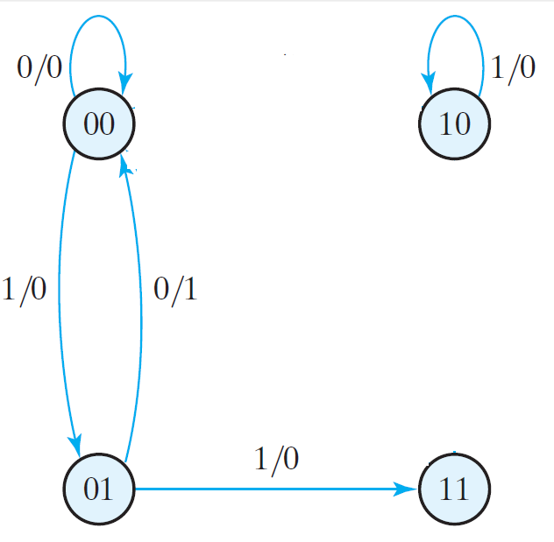
STATE DIAGRAM:
PRESENT STATE |  | NEXT STATE |  |  |  | OUTPUT
 |  | x=0 |  | x=1 |  | x=0 | x=1
A | B | A | B | A | B | y | y
0 | 0 | 0 | 0 | 0 | 1 | 0 | 0
0 | 1 | 0 | 0 | 1 | 1 | 1 | 0
1 | 0 | 0 | 0 | 1 | 0 | 1 | 0
1 | 1 | 0 | 0 | 1 | 0 | 1 | 0

Slide 43
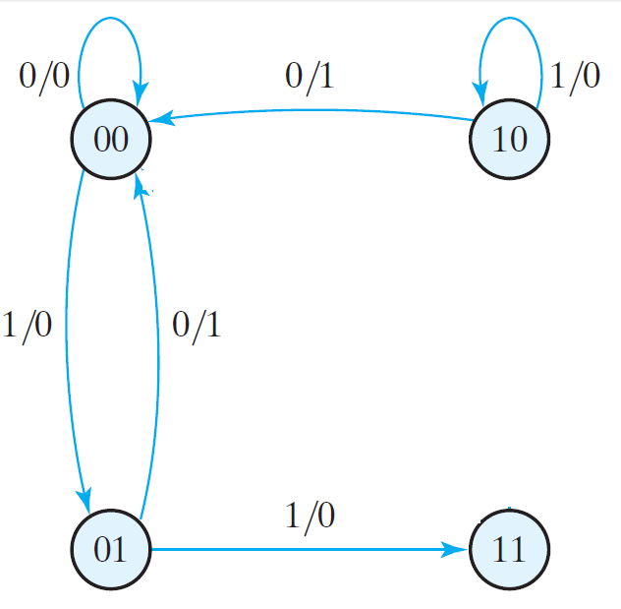
STATE DIAGRAM:
PRESENT STATE |  | NEXT STATE |  |  |  | OUTPUT
 |  | x=0 |  | x=1 |  | x=0 | x=1
A | B | A | B | A | B | y | y
0 | 0 | 0 | 0 | 0 | 1 | 0 | 0
0 | 1 | 0 | 0 | 1 | 1 | 1 | 0
1 | 0 | 0 | 0 | 1 | 0 | 1 | 0
1 | 1 | 0 | 0 | 1 | 0 | 1 | 0

Slide 44
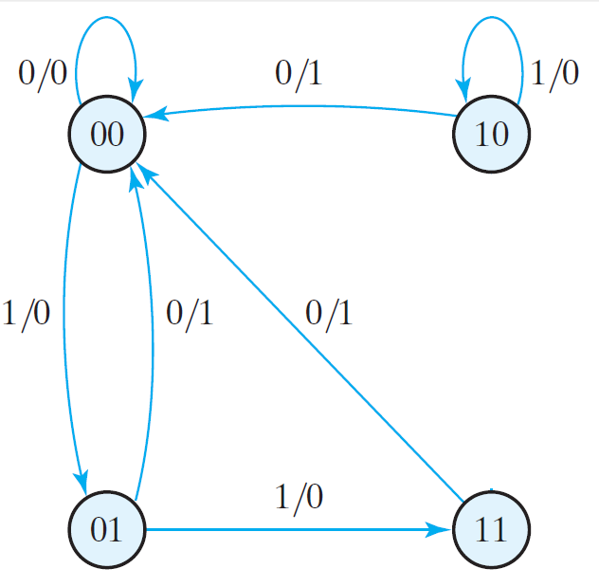
STATE DIAGRAM:
PRESENT STATE |  | NEXT STATE |  |  |  | OUTPUT
 |  | x=0 |  | x=1 |  | x=0 | x=1
A | B | A | B | A | B | y | y
0 | 0 | 0 | 0 | 0 | 1 | 0 | 0
0 | 1 | 0 | 0 | 1 | 1 | 1 | 0
1 | 0 | 0 | 0 | 1 | 0 | 1 | 0
1 | 1 | 0 | 0 | 1 | 0 | 1 | 0

Slide 45
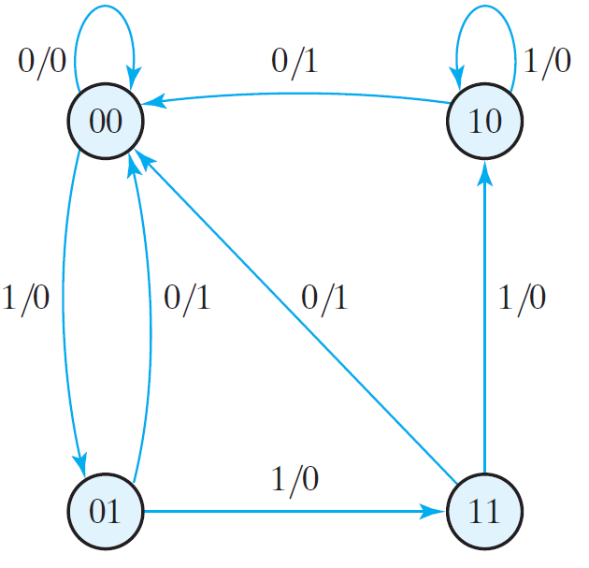
STATE DIAGRAM:
PRESENT STATE |  | NEXT STATE |  |  |  | OUTPUT
 |  | x=0 |  | x=1 |  | x=0 | x=1
A | B | A | B | A | B | y | y
0 | 0 | 0 | 0 | 0 | 1 | 0 | 0
0 | 1 | 0 | 0 | 1 | 1 | 1 | 0
1 | 0 | 0 | 0 | 1 | 0 | 1 | 0
1 | 1 | 0 | 0 | 1 | 0 | 1 | 0

Slide 46
STATE DIAGRAM:
PRESENT STATE |  | NEXT STATE |  |  |  | OUTPUT
 |  | x=0 |  | x=1 |  | x=0 | x=1
A | B | A | B | A | B | y | y
0 | 0 | 0 | 0 | 0 | 1 | 0 | 0
0 | 1 | 0 | 0 | 1 | 1 | 1 | 0
1 | 0 | 0 | 0 | 1 | 0 | 1 | 0
1 | 1 | 0 | 0 | 1 | 0 | 1 | 0

Slide 47
ANALYSIS OF CLOCKED SEQENTIAL CIRCUITS

Slide 48
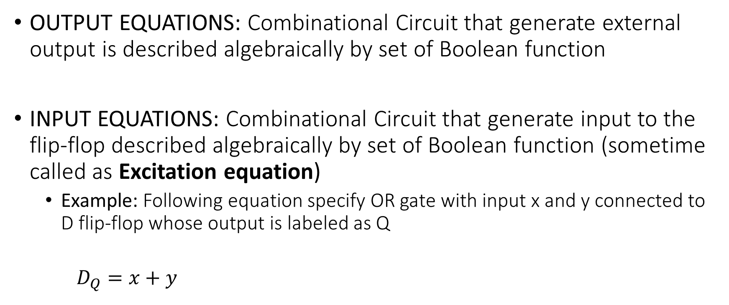
FLIP FLOP EQUATIONS
OUTPUT EQUATIONS: Combinational Circuit that generate external output is described algebraically by set of Boolean function
INPUT EQUATIONS: Combinational Circuit that generate input to the flip-flop described algebraically by set of Boolean function (sometime called as Excitation equation)
Example: Following equation specify OR gate with input x and y connected to D flip-flop whose output is labeled as Q
$D_{Q}=x+y$

Slide 49

FLIP FLOP EQUATIONS
OUTPUT EQUATIONS:
$y=(A+B).\overline{x}$
INPUT EQUATIONS:
$D_{A}=A.x+B.x$
$D_{B}=\overline{A}.x$

Slide 50
Analysis of CLOCKED SEQENTIAL CIRCUITS
EXAMPLE 2

Slide 51
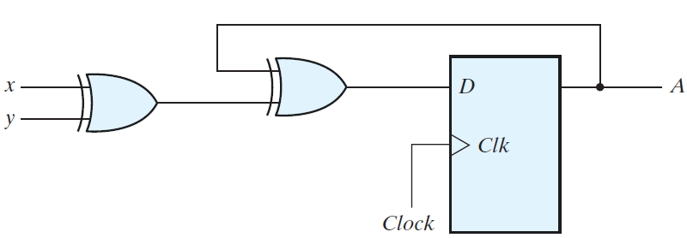


CIRCUIT DIAGRAM
STATE EQUATION (INPUT EQUATION)
$$D_{A\left(t+1\right)=}A\left(t\right)+ x+ y$$
$$D_{A=}A+ x+ y$$

Slide 52


STATE EQUATION (INPUT EQUATION)
$$D_{A\left(t+1\right)=}A\left(t\right)+ x+ y$$
$$D_{A=}A+ x+ y$$

Slide 53
STATE TABLE: PRESENT STATE
State of flip flop A
PRESENT STATE
A
0
1

Slide 54
STATE TABLE: PRESENT STATE,INPUT
INPUT x and y
PRESENT STATE | INPUT
A | x | y
0 | 0 | 0
0 | 0 | 1
0 | 1 | 0
0 | 1 | 1
1 | 0 | 0
1 | 0 | 1
1 | 1 | 0
1 | 1 | 1

Slide 55


STATE TABLE: PRESENT STATE,INPUT
Next state for A(t+1)
PRESENT STATE | INPUT |  | NEXT STATE
A | x | y | A(t+1)
0 | 0 | 0 | 0
0 | 0 | 1
0 | 1 | 0
0 | 1 | 1
1 | 0 | 0
1 | 0 | 1
1 | 1 | 0
1 | 1 | 1

Slide 56
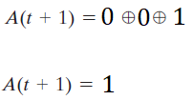
STATE TABLE: PRESENT STATE,INPUT
Next state for A(t+1)
PRESENT STATE | INPUT |  | NEXT STATE
A | x | y | A(t+1)
0 | 0 | 0 | 0
0 | 0 | 1 | 1
0 | 1 | 0
0 | 1 | 1
1 | 0 | 0
1 | 0 | 1
1 | 1 | 0
1 | 1 | 1

Slide 57
STATE TABLE: PRESENT STATE,INPUT, NEXT STATE
Next state for A(t+1)
PRESENT STATE | INPUT |  | NEXT STATE
A | x | y | A(t+1)
0 | 0 | 0 | 0
0 | 0 | 1 | 1
0 | 1 | 0 | 1
0 | 1 | 1 | 0
1 | 0 | 0 | 1
1 | 0 | 1 | 0
1 | 1 | 0 | 0
1 | 1 | 1 | 1

Slide 58
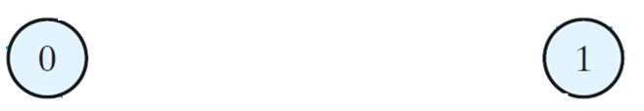
STATE DIAGRAM:
PRESENT STATE | INPUT |  | NEXT STATE
A | x | y | A(t+1)
0 | 0 | 0 | 0
0 | 0 | 1 | 1
0 | 1 | 0 | 1
0 | 1 | 1 | 0
1 | 0 | 0 | 1
1 | 0 | 1 | 0
1 | 1 | 0 | 0
1 | 1 | 1 | 1

Slide 59
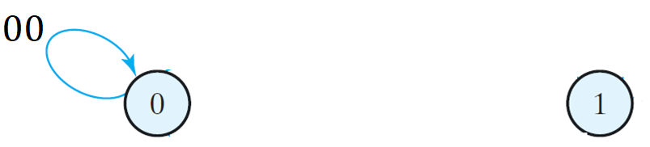
STATE DIAGRAM:
PRESENT STATE | INPUT |  | NEXT STATE
A | x | y | A(t+1)
0 | 0 | 0 | 0
0 | 0 | 1 | 1
0 | 1 | 0 | 1
0 | 1 | 1 | 0
1 | 0 | 0 | 1
1 | 0 | 1 | 0
1 | 1 | 0 | 0
1 | 1 | 1 | 1

Slide 60
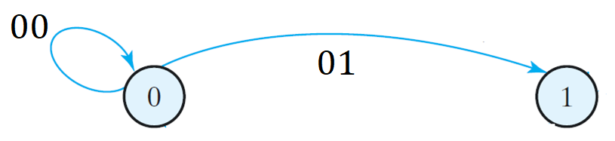
STATE DIAGRAM:
PRESENT STATE | INPUT |  | NEXT STATE
A | x | y | A(t+1)
0 | 0 | 0 | 0
0 | 0 | 1 | 1
0 | 1 | 0 | 1
0 | 1 | 1 | 0
1 | 0 | 0 | 1
1 | 0 | 1 | 0
1 | 1 | 0 | 0
1 | 1 | 1 | 1

Slide 61
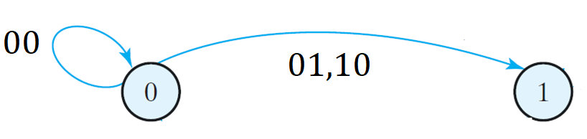
STATE DIAGRAM:
PRESENT STATE | INPUT |  | NEXT STATE
A | x | y | A(t+1)
0 | 0 | 0 | 0
0 | 0 | 1 | 1
0 | 1 | 0 | 1
0 | 1 | 1 | 0
1 | 0 | 0 | 1
1 | 0 | 1 | 0
1 | 1 | 0 | 0
1 | 1 | 1 | 1

Slide 62
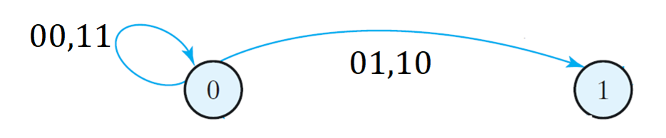
STATE DIAGRAM:
PRESENT STATE | INPUT |  | NEXT STATE
A | x | y | A(t+1)
0 | 0 | 0 | 0
0 | 0 | 1 | 1
0 | 1 | 0 | 1
0 | 1 | 1 | 0
1 | 0 | 0 | 1
1 | 0 | 1 | 0
1 | 1 | 0 | 0
1 | 1 | 1 | 1

Slide 63
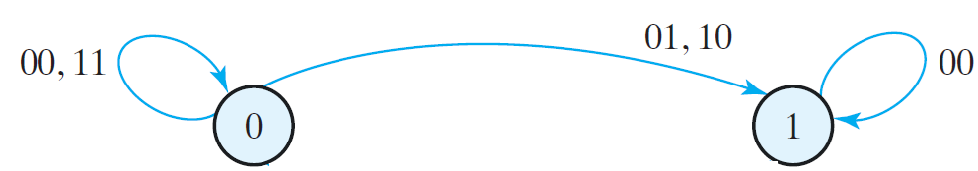
STATE DIAGRAM:
PRESENT STATE | INPUT |  | NEXT STATE
A | x | y | A(t+1)
0 | 0 | 0 | 0
0 | 0 | 1 | 1
0 | 1 | 0 | 1
0 | 1 | 1 | 0
1 | 0 | 0 | 1
1 | 0 | 1 | 0
1 | 1 | 0 | 0
1 | 1 | 1 | 1

Slide 64
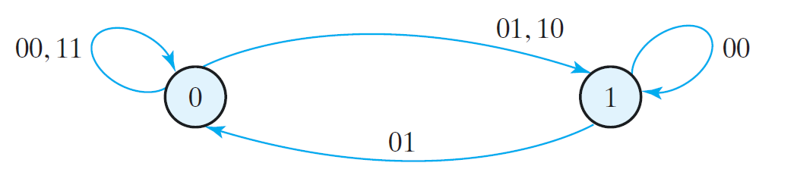
STATE DIAGRAM:
PRESENT STATE | INPUT |  | NEXT STATE
A | x | y | A(t+1)
0 | 0 | 0 | 0
0 | 0 | 1 | 1
0 | 1 | 0 | 1
0 | 1 | 1 | 0
1 | 0 | 0 | 1
1 | 0 | 1 | 0
1 | 1 | 0 | 0
1 | 1 | 1 | 1

Slide 65
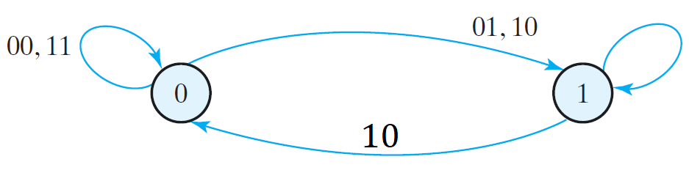
STATE DIAGRAM:
PRESENT STATE | INPUT |  | NEXT STATE
A | x | y | A(t+1)
0 | 0 | 0 | 0
0 | 0 | 1 | 1
0 | 1 | 0 | 1
0 | 1 | 1 | 0
1 | 0 | 0 | 1
1 | 0 | 1 | 0
1 | 1 | 0 | 0
1 | 1 | 1 | 1

Slide 66
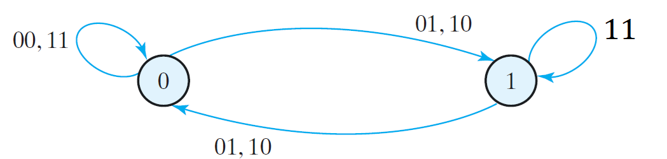
STATE DIAGRAM:
PRESENT STATE | INPUT |  | NEXT STATE
A | x | y | A(t+1)
0 | 0 | 0 | 0
0 | 0 | 1 | 1
0 | 1 | 0 | 1
0 | 1 | 1 | 0
1 | 0 | 0 | 1
1 | 0 | 1 | 0
1 | 1 | 0 | 0
1 | 1 | 1 | 1

Slide 67
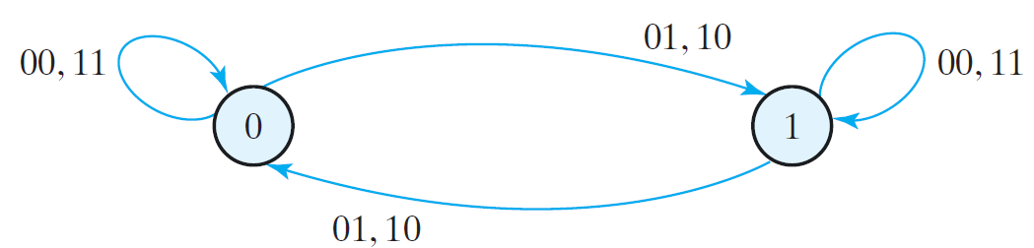
STATE DIAGRAM:
PRESENT STATE | INPUT |  | NEXT STATE
A | x | y | A(t+1)
0 | 0 | 0 | 0
0 | 0 | 1 | 1
0 | 1 | 0 | 1
0 | 1 | 1 | 0
1 | 0 | 0 | 1
1 | 0 | 1 | 0
1 | 1 | 0 | 0
1 | 1 | 1 | 1

Slide 68
Analysis of CLOCKED SEQENTIAL CIRCUITS
Using JK FLIP-FLOP

Slide 69
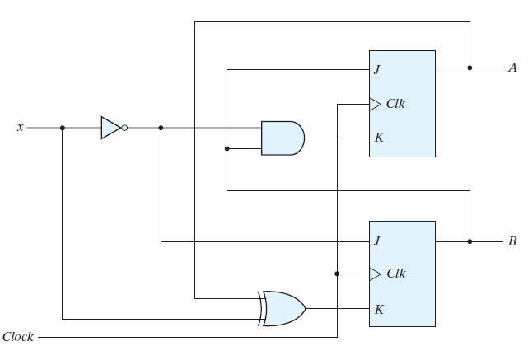
CIRCUIT DIAGRAM

Slide 70
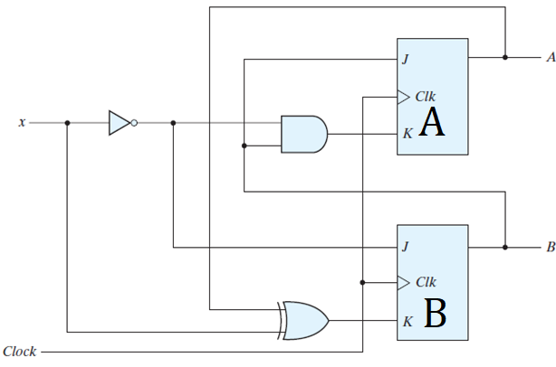

STATE EQUATIONS
$$J_{A}=B$$
$$K_{A}=B.\overline{x}$$
$$J_{B }=\overline{x}$$
$$K_{B}=A ⨁x$$

Slide 71
STATE TABLE: PRESENT STATE & INPUT
PRESENT STATE |  | INPUT
A | B | x
0 | 0 | 0
0 | 0 | 1
0 | 1 | 0
0 | 1 | 1
1 | 0 | 0
1 | 0 | 1
1 | 1 | 0
1 | 1 | 1

Slide 72

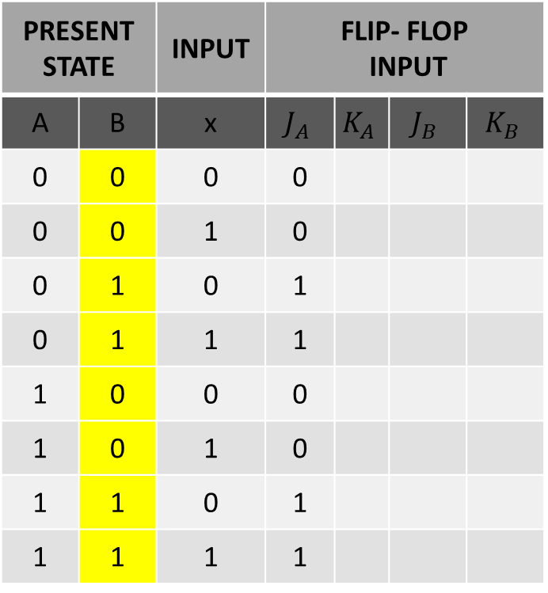
STATE TABLE: PRESENT STATE, INPUT & FLIP-FLOP INPUTS
$J_{A(t+1)}=B(t)$
PRESENT STATE |  | INPUT | FLIP- FLOP INPUT
A | B | x | $$J_{A}$$ | $$K_{A}$$ | $$J_{B}$$ | $$K_{B}$$
0 | 0 | 0 | 0
0 | 0 | 1 | 0
0 | 1 | 0 | 1
0 | 1 | 1 | 1
1 | 0 | 0 | 0
1 | 0 | 1 | 0
1 | 1 | 0 | 1
1 | 1 | 1 | 1

Slide 73

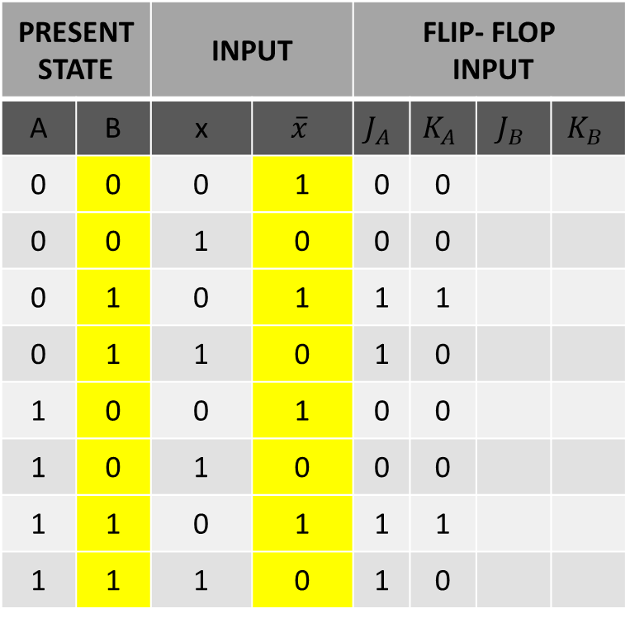
STATE TABLE: PRESENT STATE, INPUT & FLIP-FLOP INPUTS
$$K_{A}=B.\overline{x}$$
PRESENT STATE |  | INPUT |  | FLIP- FLOP INPUT
A | B | x | $$\overline{x}$$ | $$J_{A}$$ | $$K_{A}$$ | $$J_{B}$$ | $$K_{B}$$
0 | 0 | 0 | 1 | 0 | 0
0 | 0 | 1 | 0 | 0 | 0
0 | 1 | 0 | 1 | 1 | 1
0 | 1 | 1 | 0 | 1 | 0
1 | 0 | 0 | 1 | 0 | 0
1 | 0 | 1 | 0 | 0 | 0
1 | 1 | 0 | 1 | 1 | 1
1 | 1 | 1 | 0 | 1 | 0

Slide 74

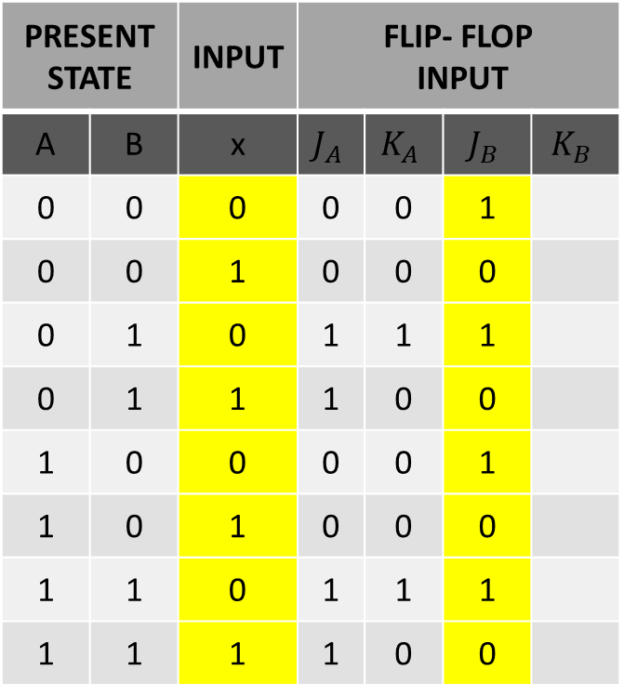
STATE TABLE: PRESENT STATE, INPUT & FLIP-FLOP INPUTS
$$J_{B }=\overline{x}$$
PRESENT STATE |  | INPUT | FLIP- FLOP INPUT
A | B | x | $$J_{A}$$ | $$K_{A}$$ | $$J_{B}$$ | $$K_{B}$$
0 | 0 | 0 | 0 | 0 | 1
0 | 0 | 1 | 0 | 0 | 0
0 | 1 | 0 | 1 | 1 | 1
0 | 1 | 1 | 1 | 0 | 0
1 | 0 | 0 | 0 | 0 | 1
1 | 0 | 1 | 0 | 0 | 0
1 | 1 | 0 | 1 | 1 | 1
1 | 1 | 1 | 1 | 0 | 0

Slide 75

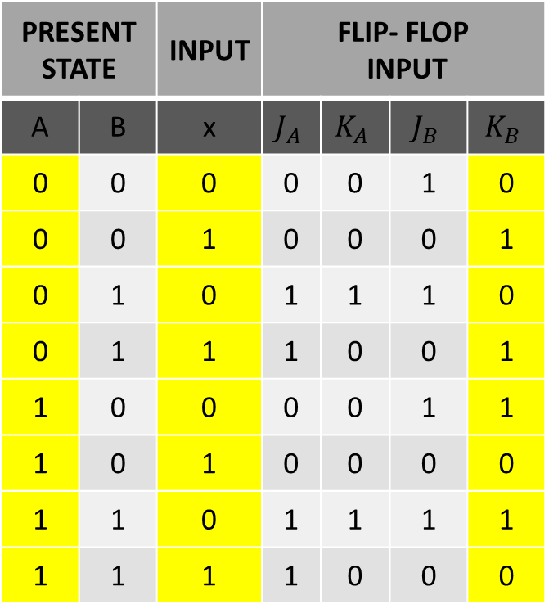
STATE TABLE: PRESENT STATE, INPUT & FLIP-FLOP INPUTS
$$K_{B}=A ⨁x$$
PRESENT STATE |  | INPUT | FLIP- FLOP INPUT
A | B | x | $$J_{A}$$ | $$K_{A}$$ | $$J_{B}$$ | $$K_{B}$$
0 | 0 | 0 | 0 | 0 | 1 | 0
0 | 0 | 1 | 0 | 0 | 0 | 1
0 | 1 | 0 | 1 | 1 | 1 | 0
0 | 1 | 1 | 1 | 0 | 0 | 1
1 | 0 | 0 | 0 | 0 | 1 | 1
1 | 0 | 1 | 0 | 0 | 0 | 0
1 | 1 | 0 | 1 | 1 | 1 | 1
1 | 1 | 1 | 1 | 0 | 0 | 0

Slide 76
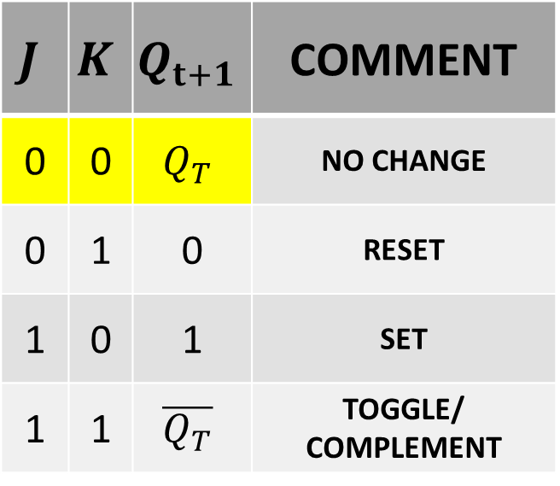
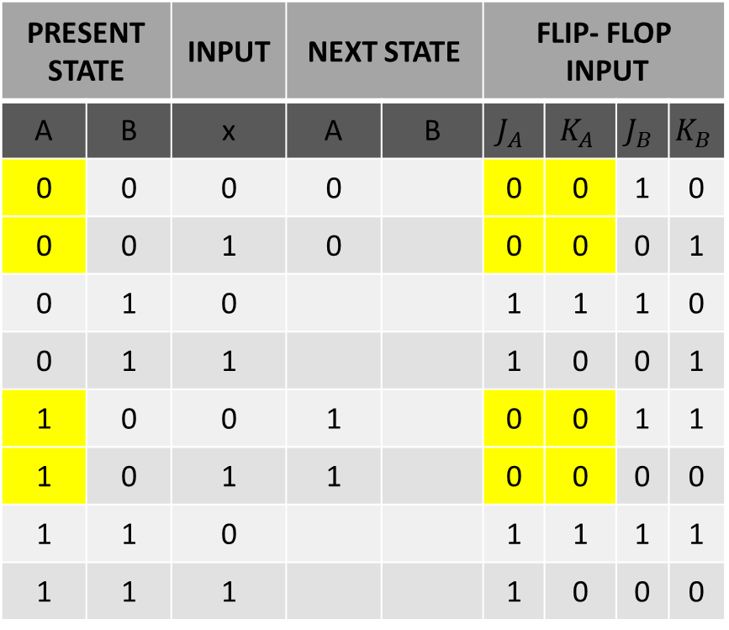
STATE TABLE: PRESENT STATE, INPUT, FLIP-FLOP INPUTS & NEXT STATE
PRESENT STATE |  | INPUT | NEXT STATE |  | FLIP- FLOP INPUT
A | B | x | A | B | $$J_{A}$$ | $$K_{A}$$ | $$J_{B}$$ | $$K_{B}$$
0 | 0 | 0 | 0 |  | 0 | 0 | 1 | 0
0 | 0 | 1 | 0 |  | 0 | 0 | 0 | 1
0 | 1 | 0 |  |  | 1 | 1 | 1 | 0
0 | 1 | 1 |  |  | 1 | 0 | 0 | 1
1 | 0 | 0 | 1 |  | 0 | 0 | 1 | 1
1 | 0 | 1 | 1 |  | 0 | 0 | 0 | 0
1 | 1 | 0 |  |  | 1 | 1 | 1 | 1
1 | 1 | 1 |  |  | 1 | 0 | 0 | 0
$$J$$ | $$K$$ | $$Q_{t+1}$$ | COMMENT
0 | 0 | $$Q_{T}$$ | NO CHANGE
0 | 1 | 0 | RESET
1 | 0 | 1 | SET
1 | 1 | $$\overline{Q_{T}}$$ | TOGGLE/ COMPLEMENT

Slide 77
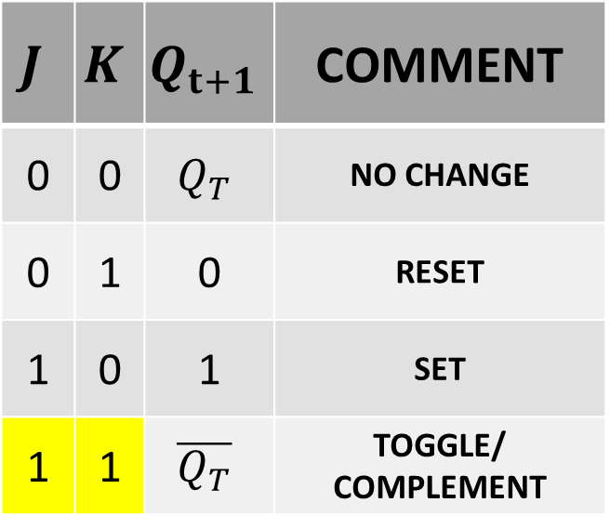
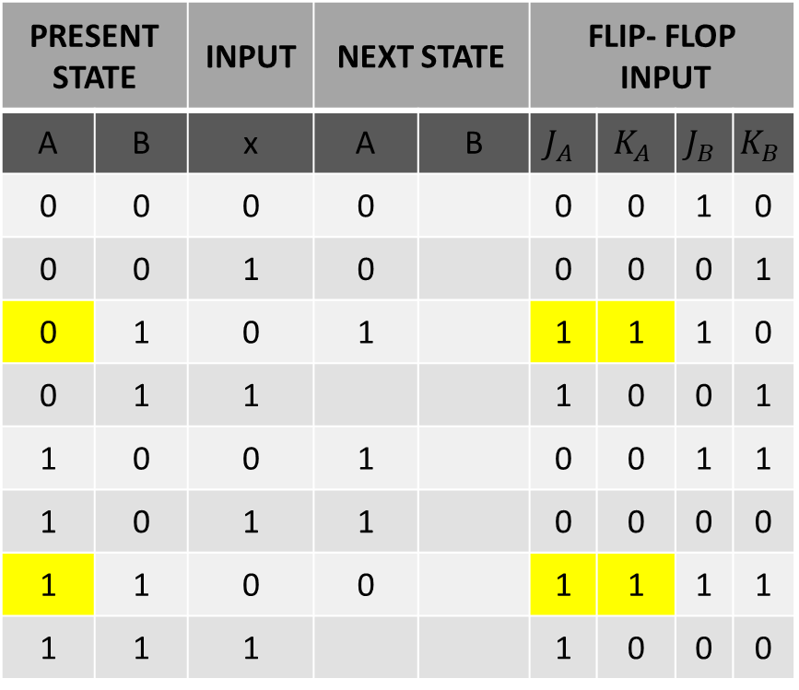
STATE TABLE: PRESENT STATE, INPUT, FLIP-FLOP INPUTS & NEXT STATE
PRESENT STATE |  | INPUT | NEXT STATE |  | FLIP- FLOP INPUT
A | B | x | A | B | $$J_{A}$$ | $$K_{A}$$ | $$J_{B}$$ | $$K_{B}$$
0 | 0 | 0 | 0 |  | 0 | 0 | 1 | 0
0 | 0 | 1 | 0 |  | 0 | 0 | 0 | 1
0 | 1 | 0 | 1 |  | 1 | 1 | 1 | 0
0 | 1 | 1 |  |  | 1 | 0 | 0 | 1
1 | 0 | 0 | 1 |  | 0 | 0 | 1 | 1
1 | 0 | 1 | 1 |  | 0 | 0 | 0 | 0
1 | 1 | 0 | 0 |  | 1 | 1 | 1 | 1
1 | 1 | 1 |  |  | 1 | 0 | 0 | 0
$$J$$ | $$K$$ | $$Q_{t+1}$$ | COMMENT
0 | 0 | $$Q_{T}$$ | NO CHANGE
0 | 1 | 0 | RESET
1 | 0 | 1 | SET
1 | 1 | $$\overline{Q_{T}}$$ | TOGGLE/ COMPLEMENT

Slide 78
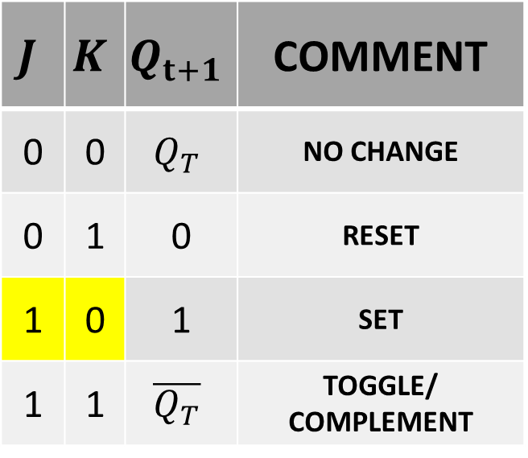
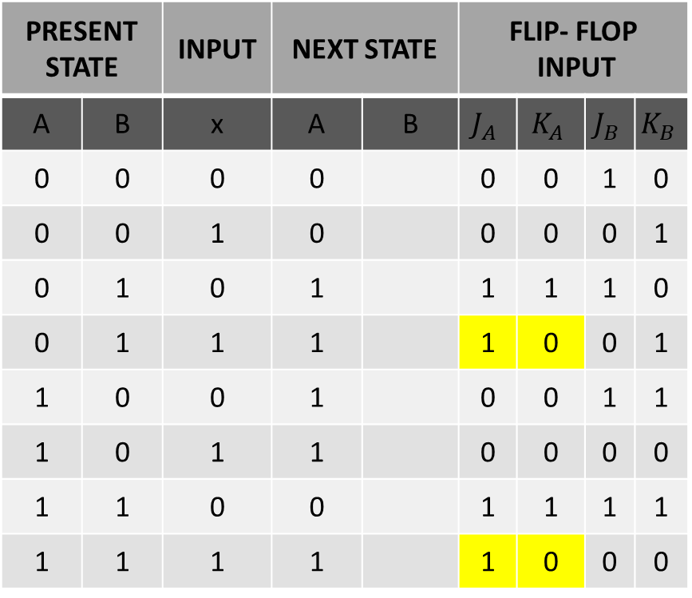
STATE TABLE: PRESENT STATE, INPUT, FLIP-FLOP INPUTS & NEXT STATE
PRESENT STATE |  | INPUT | NEXT STATE |  | FLIP- FLOP INPUT
A | B | x | A | B | $$J_{A}$$ | $$K_{A}$$ | $$J_{B}$$ | $$K_{B}$$
0 | 0 | 0 | 0 |  | 0 | 0 | 1 | 0
0 | 0 | 1 | 0 |  | 0 | 0 | 0 | 1
0 | 1 | 0 | 1 |  | 1 | 1 | 1 | 0
0 | 1 | 1 | 1 |  | 1 | 0 | 0 | 1
1 | 0 | 0 | 1 |  | 0 | 0 | 1 | 1
1 | 0 | 1 | 1 |  | 0 | 0 | 0 | 0
1 | 1 | 0 | 0 |  | 1 | 1 | 1 | 1
1 | 1 | 1 | 1 |  | 1 | 0 | 0 | 0
$$J$$ | $$K$$ | $$Q_{t+1}$$ | COMMENT
0 | 0 | $$Q_{T}$$ | NO CHANGE
0 | 1 | 0 | RESET
1 | 0 | 1 | SET
1 | 1 | $$\overline{Q_{T}}$$ | TOGGLE/ COMPLEMENT

Slide 79
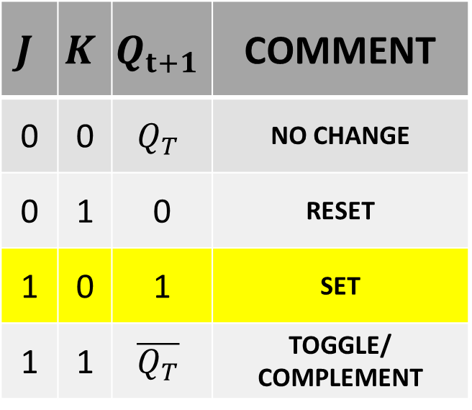
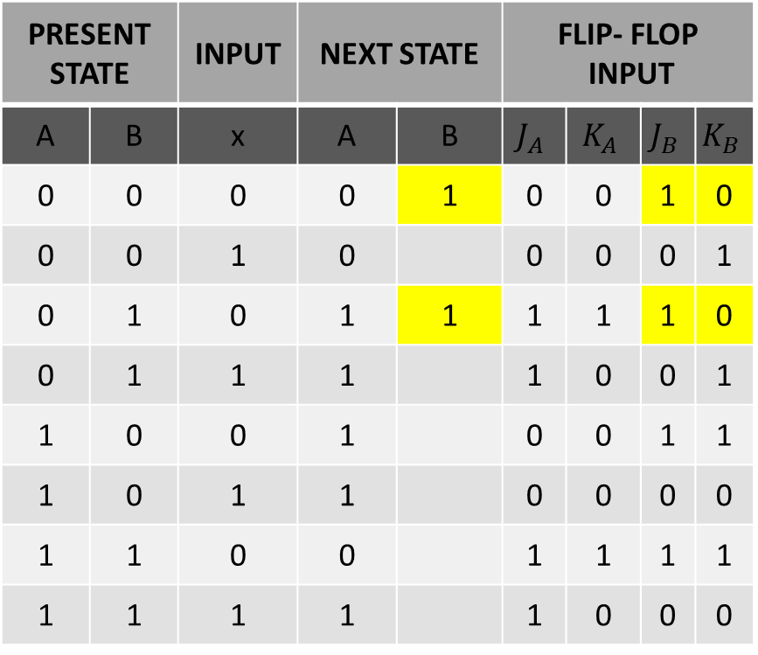
STATE TABLE: PRESENT STATE, INPUT, FLIP-FLOP INPUTS & NEXT STATE
PRESENT STATE |  | INPUT | NEXT STATE |  | FLIP- FLOP INPUT
A | B | x | A | B | $$J_{A}$$ | $$K_{A}$$ | $$J_{B}$$ | $$K_{B}$$
0 | 0 | 0 | 0 | 1 | 0 | 0 | 1 | 0
0 | 0 | 1 | 0 |  | 0 | 0 | 0 | 1
0 | 1 | 0 | 1 | 1 | 1 | 1 | 1 | 0
0 | 1 | 1 | 1 |  | 1 | 0 | 0 | 1
1 | 0 | 0 | 1 |  | 0 | 0 | 1 | 1
1 | 0 | 1 | 1 |  | 0 | 0 | 0 | 0
1 | 1 | 0 | 0 |  | 1 | 1 | 1 | 1
1 | 1 | 1 | 1 |  | 1 | 0 | 0 | 0
$$J$$ | $$K$$ | $$Q_{t+1}$$ | COMMENT
0 | 0 | $$Q_{T}$$ | NO CHANGE
0 | 1 | 0 | RESET
1 | 0 | 1 | SET
1 | 1 | $$\overline{Q_{T}}$$ | TOGGLE/ COMPLEMENT

Slide 80


STATE TABLE: PRESENT STATE, INPUT, FLIP-FLOP INPUTS & NEXT STATE
PRESENT STATE |  | INPUT | NEXT STATE |  | FLIP- FLOP INPUT
A | B | x | A | B | $$J_{A}$$ | $$K_{A}$$ | $$J_{B}$$ | $$K_{B}$$
0 | 0 | 0 | 0 | 1 | 0 | 0 | 1 | 0
0 | 0 | 1 | 0 | 0 | 0 | 0 | 0 | 1
0 | 1 | 0 | 1 | 1 | 1 | 1 | 1 | 0
0 | 1 | 1 | 1 | 0 | 1 | 0 | 0 | 1
1 | 0 | 0 | 1 |  | 0 | 0 | 1 | 1
1 | 0 | 1 | 1 |  | 0 | 0 | 0 | 0
1 | 1 | 0 | 0 |  | 1 | 1 | 1 | 1
1 | 1 | 1 | 1 |  | 1 | 0 | 0 | 0
$$J$$ | $$K$$ | $$Q_{t+1}$$ | COMMENT
0 | 0 | $$Q_{T}$$ | NO CHANGE
0 | 1 | 0 | RESET
1 | 0 | 1 | SET
1 | 1 | $$\overline{Q_{T}}$$ | TOGGLE/ COMPLEMENT

Slide 81


STATE TABLE: PRESENT STATE, INPUT, FLIP-FLOP INPUTS & NEXT STATE
PRESENT STATE |  | INPUT | NEXT STATE |  | FLIP- FLOP INPUT
A | B | x | A | B | $$J_{A}$$ | $$K_{A}$$ | $$J_{B}$$ | $$K_{B}$$
0 | 0 | 0 | 0 | 1 | 0 | 0 | 1 | 0
0 | 0 | 1 | 0 | 0 | 0 | 0 | 0 | 1
0 | 1 | 0 | 1 | 1 | 1 | 1 | 1 | 0
0 | 1 | 1 | 1 | 0 | 1 | 0 | 0 | 1
1 | 0 | 0 | 1 | 0 | 0 | 0 | 1 | 1
1 | 0 | 1 | 1 |  | 0 | 0 | 0 | 0
1 | 1 | 0 | 0 | 0 | 1 | 1 | 1 | 1
1 | 1 | 1 | 1 |  | 1 | 0 | 0 | 0
$$J$$ | $$K$$ | $$Q_{t+1}$$ | COMMENT
0 | 0 | $$Q_{T}$$ | NO CHANGE
0 | 1 | 0 | RESET
1 | 0 | 1 | SET
1 | 1 | $$\overline{Q_{T}}$$ | TOGGLE/ COMPLEMENT

Slide 82


STATE TABLE: PRESENT STATE, INPUT, FLIP-FLOP INPUTS & NEXT STATE
PRESENT STATE |  | INPUT | NEXT STATE |  | FLIP- FLOP INPUT
A | B | x | A | B | $$J_{A}$$ | $$K_{A}$$ | $$J_{B}$$ | $$K_{B}$$
0 | 0 | 0 | 0 | 1 | 0 | 0 | 1 | 0
0 | 0 | 1 | 0 | 0 | 0 | 0 | 0 | 1
0 | 1 | 0 | 1 | 1 | 1 | 1 | 1 | 0
0 | 1 | 1 | 1 | 0 | 1 | 0 | 0 | 1
1 | 0 | 0 | 1 | 0 | 0 | 0 | 1 | 1
1 | 0 | 1 | 1 | 1 | 0 | 0 | 0 | 0
1 | 1 | 0 | 0 | 0 | 1 | 1 | 1 | 1
1 | 1 | 1 | 1 | 1 | 1 | 0 | 0 | 0
$$J$$ | $$K$$ | $$Q_{t+1}$$ | COMMENT
0 | 0 | $$Q_{T}$$ | NO CHANGE
0 | 1 | 0 | RESET
1 | 0 | 1 | SET
1 | 1 | $$\overline{Q_{T}}$$ | TOGGLE/ COMPLEMENT

Slide 83

STATE TABLE: PRESENT STATE, INPUT, FLIP-FLOP INPUTS & NEXT STATE
PRESENT STATE |  | INPUT | NEXT STATE |  | FLIP- FLOP INPUT
A | B | x | A | B | $$J_{A}$$ | $$K_{A}$$ | $$J_{B}$$ | $$K_{B}$$
0 | 0 | 0 | 0 | 1 | 0 | 0 | 1 | 0
0 | 0 | 1 | 0 | 0 | 0 | 0 | 0 | 1
0 | 1 | 0 | 1 | 1 | 1 | 1 | 1 | 0
0 | 1 | 1 | 1 | 0 | 1 | 0 | 0 | 1
1 | 0 | 0 | 1 | 0 | 0 | 0 | 1 | 1
1 | 0 | 1 | 1 | 1 | 0 | 0 | 0 | 0
1 | 1 | 0 | 0 | 0 | 1 | 1 | 1 | 1
1 | 1 | 1 | 1 | 1 | 1 | 0 | 0 | 0

Slide 84
STATE TABLE: PRESENT STATE, INPUT, FLIP-FLOP INPUTS & NEXT STATE
PRESENT STATE |  | INPUT | NEXT STATE
A | B | x | A | B
0 | 0 | 0 | 0 | 1
0 | 0 | 1 | 0 | 0
0 | 1 | 0 | 1 | 1
0 | 1 | 1 | 1 | 0
1 | 0 | 0 | 1 | 0
1 | 0 | 1 | 1 | 1
1 | 1 | 0 | 0 | 0
1 | 1 | 1 | 1 | 1

Slide 85


JK-FLIP-FLOP
$${Q_{T+1}=J\overline{Q_{T}}+\overline{K}Q}_{T}$$

Slide 86




STATE TABLE: PRESENT STATE, INPUT, NEXT STATE FOR FLIP FLOP A
$${ J}_{A}=B, K_{A}=B.\overline{x}$$
$${A_{T+1}=J_{A}\overline{A_{T}}+\overline{K_{A}}A}_{T}$$
PRESENT STATE |  | INPUT
A | B | x
0 | 0 | 0
0 | 0 | 1
0 | 1 | 0
0 | 1 | 1
1 | 0 | 0
1 | 0 | 1
1 | 1 | 0
1 | 1 | 1
$${A_{T+1}=B\overline{A_{T}}+(\overline{B.\overline{x}})A}_{T}$$
$${A_{T+1}=B.\overline{A_{T}}+\left(\overline{B}+x\right).A}_{T}$$
$${A_{T+1}=B.\overline{A_{T}}+\overline{B}.A}_{T}+x.A_{T}$$
$${A_{T+1}=\overline{A_{T}}.B+A_{T}.\overline{B} }_{ }+A_{T}.x$$
$${A_{T+1}=\overline{A}.B+A.\overline{B} }_{ }+A.x$$

Slide 87




STATE TABLE: PRESENT STATE, INPUT, NEXT STATE FOR FLIP FLOP A
$${A_{T+1}=\overline{A}.B+A\overline{.B} }_{ }+A.x$$
PRESENT STATE |  | INPUT | NEXT STATE
A | B | x | A | B
0 | 0 | 0 | 0
0 | 0 | 1
0 | 1 | 0
0 | 1 | 1
1 | 0 | 0
1 | 0 | 1
1 | 1 | 0
1 | 1 | 1
$${A_{T+1}=\overline{0}.0+0.\overline{0} }_{ }+0.0$$
$${A_{T+1}=0+0 }_{ }+0$$
$${A_{T+1}=0 }_{ }$$

Slide 88

STATE TABLE: PRESENT STATE, INPUT, NEXT STATE FOR FLIP FLOP A
$${A_{T+1}=\overline{A}.B+A\overline{.B} }_{ }+A.x$$
PRESENT STATE |  | INPUT | NEXT STATE
A | B | x | A | B
0 | 0 | 0 | 0
0 | 0 | 1 | 0
0 | 1 | 0
0 | 1 | 1
1 | 0 | 0
1 | 0 | 1
1 | 1 | 0
1 | 1 | 1
$${A_{T+1}=\overline{0}.0+0.\overline{0} }_{ }+0.1$$
$${A_{T+1}=0+0 }_{ }+0$$
$${A_{T+1}=0 }_{ }$$

Slide 89



STATE TABLE: PRESENT STATE, INPUT, NEXT STATE FOR FLIP FLOP A
$${A_{T+1}=\overline{A}.B+A\overline{.B} }_{ }+A.x$$
PRESENT STATE |  | INPUT | NEXT STATE
A | B | x | A | B
0 | 0 | 0 | 0
0 | 0 | 1 | 0
0 | 1 | 0 | 1
0 | 1 | 1 | 1
1 | 0 | 0
1 | 0 | 1
1 | 1 | 0
1 | 1 | 1
$${A_{T+1}=\overline{0}.1+0.\overline{1} }_{ }+0.1$$
$${A_{T+1}=1+0 }_{ }+0$$
$${A_{T+1}=1 }_{ }$$

Slide 90


STATE TABLE: PRESENT STATE, INPUT, NEXT STATE FOR FLIP FLOP A
$${A_{T+1}=\overline{A}.B+A\overline{.B} }_{ }+A.x$$
PRESENT STATE |  | INPUT | NEXT STATE
A | B | x | A | B
0 | 0 | 0 | 0
0 | 0 | 1 | 0
0 | 1 | 0 | 1
0 | 1 | 1 | 1
1 | 0 | 0 | 1
1 | 0 | 1 | 1
1 | 1 | 0
1 | 1 | 1
$${A_{T+1}=\overline{1}.0+1.\overline{0} }_{ }+1.0$$
$${A_{T+1}=0+1 }_{ }+0$$
$${A_{T+1}=1 }_{ }$$

Slide 91






STATE TABLE: PRESENT STATE, INPUT, NEXT STATE FOR FLIP FLOP A
$${A_{T+1}=\overline{A}.B+A\overline{.B} }_{ }+A.x$$
PRESENT STATE |  | INPUT | NEXT STATE
A | B | x | A | B
0 | 0 | 0 | 0
0 | 0 | 1 | 0
0 | 1 | 0 | 1
0 | 1 | 1 | 1
1 | 0 | 0 | 1
1 | 0 | 1 | 1
1 | 1 | 0 | 0
1 | 1 | 1 | 1
$${A_{T+1}=\overline{1}.1+1.\overline{1} }_{ }+1.0$$
$${A_{T+1}=0+0 }_{ }+0$$
$${A_{T+1}=0 }_{ }$$
$${A_{T+1}=\overline{A}.B+A\overline{.B} }_{ }+A.x$$
$${A_{T+1}=\overline{1}.1+1.\overline{1} }_{ }+1.1$$
$${A_{T+1}=0+0 }_{ }+1$$
$${A_{T+1}=1 }_{ }$$

Slide 92




STATE TABLE: PRESENT STATE, INPUT, NEXT STATE FOR FLIP FLOP B
$${B_{T+1}=J_{B}\overline{B_{T}}+\overline{K_{B}}B}_{T}$$
PRESENT STATE |  | INPUT | NEXT STATE
A | B | x | A | B
0 | 0 | 0 | 0
0 | 0 | 1 | 0
0 | 1 | 0 | 1
0 | 1 | 1 | 1
1 | 0 | 0 | 1
1 | 0 | 1 | 1
1 | 1 | 0 | 0
1 | 1 | 1 | 1
$$J_{B }=\overline{x}$$
$$K_{B}=A ⨁x$$
$${B_{T+1}=\overline{x} \overline{B_{T}}+(\overline{A ⨁x } )B}_{T}$$
$${B_{T+1}=\overline{x} \overline{B_{T}}+(A.x+\overline{A}.\overline{x})B}_{T}$$
$${B_{T+1}=\overline{x} \overline{B_{T}}+A.B_{T}.x+\overline{A}.B}_{T}.\overline{x}$$
$${B_{T+1}=\overline{x} \overline{B}+A.B.x+\overline{A}. \overline{x}}_{}$$

Slide 93



STATE TABLE: PRESENT STATE, INPUT, NEXT STATE FOR FLIP FLOP B
$${B_{T+1}=\overline{x} \overline{B}+A.B.x+\overline{A}. \overline{x}}_{ }$$
PRESENT STATE |  | INPUT | NEXT STATE
A | B | x | A | B
0 | 0 | 0 | 0 | 1
0 | 0 | 1 | 0
0 | 1 | 0 | 1
0 | 1 | 1 | 1
1 | 0 | 0 | 1
1 | 0 | 1 | 1
1 | 1 | 0 | 0
1 | 1 | 1 | 1
$${B_{T+1}=\overline{0} \overline{0}+0.0.0+\overline{0}. \overline{0}}_{ }$$
$${B_{T+1}=1+0+1}_{ }$$
$${B_{T+1}=1}_{ }$$

Slide 94
STATE TABLE: PRESENT STATE, INPUT, NEXT STATE FOR FLIP FLOP A
$${B_{T+1}=\overline{x} \overline{B}+A.B.x+\overline{A}. \overline{x}}_{ }$$
PRESENT STATE |  | INPUT | NEXT STATE
A | B | x | A | B
0 | 0 | 0 | 0 | 1
0 | 0 | 1 | 0 | 0
0 | 1 | 0 | 1 | 1
0 | 1 | 1 | 1 | 0
1 | 0 | 0 | 1 | 1
1 | 0 | 1 | 1 | 0
1 | 1 | 0 | 0 | 0
1 | 1 | 1 | 1 | 1

Slide 95
STATE TABLE: PRESENT STATE, INPUT, NEXT STATE
PRESENT STATE |  | INPUT | NEXT STATE
A | B | x | A | B
0 | 0 | 0 | 0 | 1
0 | 0 | 1 | 0 | 0
0 | 1 | 0 | 1 | 1
0 | 1 | 1 | 1 | 0
1 | 0 | 0 | 1 | 1
1 | 0 | 1 | 1 | 0
1 | 1 | 0 | 0 | 0
1 | 1 | 1 | 1 | 1

Slide 96

STATE DIAGRAM
PRESENT STATE |  | INPUT | NEXT STATE
A | B | x | A | B
0 | 0 | 0 | 0 | 1
0 | 0 | 1 | 0 | 0
0 | 1 | 0 | 1 | 1
0 | 1 | 1 | 1 | 0
1 | 0 | 0 | 1 | 1
1 | 0 | 1 | 1 | 0
1 | 1 | 0 | 0 | 0
1 | 1 | 1 | 1 | 1

Slide 97

STATE DIAGRAM
PRESENT STATE |  | INPUT | NEXT STATE
A | B | x | A | B
0 | 0 | 0 | 0 | 1
0 | 0 | 1 | 0 | 0
0 | 1 | 0 | 1 | 1
0 | 1 | 1 | 1 | 0
1 | 0 | 0 | 1 | 1
1 | 0 | 1 | 1 | 0
1 | 1 | 0 | 0 | 0
1 | 1 | 1 | 1 | 1

Slide 98

STATE DIAGRAM
PRESENT STATE |  | INPUT | NEXT STATE
A | B | x | A | B
0 | 0 | 0 | 0 | 1
0 | 0 | 1 | 0 | 0
0 | 1 | 0 | 1 | 1
0 | 1 | 1 | 1 | 0
1 | 0 | 0 | 1 | 1
1 | 0 | 1 | 1 | 0
1 | 1 | 0 | 0 | 0
1 | 1 | 1 | 1 | 1

Slide 99

STATE DIAGRAM
PRESENT STATE |  | INPUT | NEXT STATE
A | B | x | A | B
0 | 0 | 0 | 0 | 1
0 | 0 | 1 | 0 | 0
0 | 1 | 0 | 1 | 1
0 | 1 | 1 | 1 | 0
1 | 0 | 0 | 1 | 1
1 | 0 | 1 | 1 | 0
1 | 1 | 0 | 0 | 0
1 | 1 | 1 | 1 | 1

Slide 100

STATE DIAGRAM
PRESENT STATE |  | INPUT | NEXT STATE
A | B | x | A | B
0 | 0 | 0 | 0 | 1
0 | 0 | 1 | 0 | 0
0 | 1 | 0 | 1 | 1
0 | 1 | 1 | 1 | 0
1 | 0 | 0 | 1 | 1
1 | 0 | 1 | 1 | 0
1 | 1 | 0 | 0 | 0
1 | 1 | 1 | 1 | 1

Slide 101

STATE DIAGRAM
PRESENT STATE |  | INPUT | NEXT STATE
A | B | x | A | B
0 | 0 | 0 | 0 | 1
0 | 0 | 1 | 0 | 0
0 | 1 | 0 | 1 | 1
0 | 1 | 1 | 1 | 0
1 | 0 | 0 | 1 | 1
1 | 0 | 1 | 1 | 0
1 | 1 | 0 | 0 | 0
1 | 1 | 1 | 1 | 1

Slide 102

STATE DIAGRAM
PRESENT STATE |  | INPUT | NEXT STATE
A | B | x | A | B
0 | 0 | 0 | 0 | 1
0 | 0 | 1 | 0 | 0
0 | 1 | 0 | 1 | 1
0 | 1 | 1 | 1 | 0
1 | 0 | 0 | 1 | 1
1 | 0 | 1 | 1 | 0
1 | 1 | 0 | 0 | 0
1 | 1 | 1 | 1 | 1

Slide 103

STATE DIAGRAM
PRESENT STATE |  | INPUT | NEXT STATE
A | B | x | A | B
0 | 0 | 0 | 0 | 1
0 | 0 | 1 | 0 | 0
0 | 1 | 0 | 1 | 1
0 | 1 | 1 | 1 | 0
1 | 0 | 0 | 1 | 1
1 | 0 | 1 | 1 | 0
1 | 1 | 0 | 0 | 0
1 | 1 | 1 | 1 | 1

Slide 104

STATE DIAGRAM
PRESENT STATE |  | INPUT | NEXT STATE
A | B | x | A | B
0 | 0 | 0 | 0 | 1
0 | 0 | 1 | 0 | 0
0 | 1 | 0 | 1 | 1
0 | 1 | 1 | 1 | 0
1 | 0 | 0 | 1 | 1
1 | 0 | 1 | 1 | 0
1 | 1 | 0 | 0 | 0
1 | 1 | 1 | 1 | 1

Slide 105
STATE DIAGRAM

Slide 106
Thanks

